Slide 1
Nonlinear dynamic Model of Glucose Insulin Beta cell interaction(Sherman Model)
Selva Maran

Slide 2
Type 2 diabetes (also referred to as adult onset or non-insulin-dependent diabetes) is associated with a deficit in the mass of beta cells (Kloppel et al., 1985), reduced insulin secretion, and resistance to the action of insulin (The Expert Committee, 1997).
The relative contribution and interaction of these defects in the pathogenesis of this disease remains to be clarified (Cerasi, 1995).

Slide 3
Glucose Insulin Beta cell Physiology – Multiple timescale
Blood glucose levels are regulated by two negative feedback loops.
In the short term, hyperglycemia stimulates a rapid increase in insulin release from the pancreatic beta cells. The associated increase in blood insulin levels causes increased glucose uptake and decreased glucose production leading to a reduction in blood glucose (Bergman et al., 1985).
Recent evidence suggests that chronic hyperglycemia may contribute to a slow second negative feedback loop by increasing the mass of insulin secreting beta-cells (Bonner-Weir et al., 1989), through changes in the rates of b-cell replication (Swenne, 1982; Hugl et al., 1998) and death (Efanova et al., 1998; Hoorens et al., 1996). An increased b-cell mass represents an increased capacity for insulin secretion which, in turn, would lead to a decrease in blood glucose.
Type 2 diabetes has been associated with defects in components of both the short-term and chronic negative feedback loops.

Slide 4
Pathophysiology of Type 2 Diabetes
Although data suggest that multiple defects are required for the onset of type 2 diabetes, it is unclear if these defects have a single causal origin or if they occur independently(Cerasi, 1995).
Experimental induction of insulin resistance using either high fat feeding (Kaiyala et al., 1999), glucocorticoid administration (Ogawa, 1992), or genetically induced obesity (Tokuyama et al., 1995) has been shown to cause type 2 diabetes under certain circumstances.
This supports the hypothesis that insulin resistance can cause b-cell defects, and hence diabetes, either by overworking the b cells (b-cell exhaustion) (De-Fronzo et al., 1992) or by toxic effects of hyperglycemia on the b cells (glucose toxicity) (Unger & Grundy, 1985).

Slide 5
However, the existence of normoglycemia in humans and animals highly resistant to insulin suggests independent defects in insulin sensitivity and b-cell function are required for type 2 diabetes (Bergman et al., 1985).
Finally, hyperglycemia is known to induce insulin resistance
(Rossetti, 1995). This supports the hypothesis that a primary insulin secretory defect that causes hyperglycemia could lead to insulin resistance and diabetes via increased glucose levels.

Slide 6
Hyperglycemia can cause both Insulin resistance and beta cell toxicity
Secretory defects -> hyperglycemia -> Insulin resistance
Insulin resistance -> hyperglycemia
Beta cell proliferation ?
Beta cell toxicity ?
Compensatory effect trigger or toxic effect trigger.

Slide 7
Factors triggering Diabetes
Inflammation
Stress and Cortisol level
Food habits and Physical activity
Genetics

Slide 8
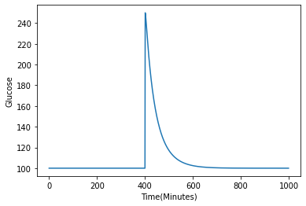
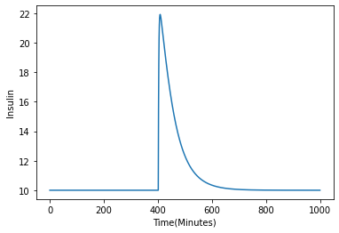
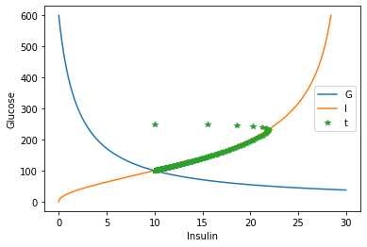
Fast dynamics
dG/dt = R₀-(E_{G0}-S_{I}*I)*G
dI/dt = β*σ*G²/(α-G²)-kI

Slide 9
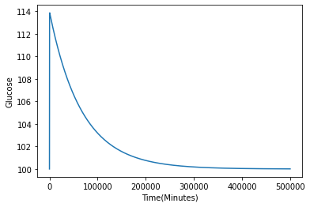
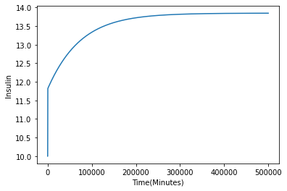
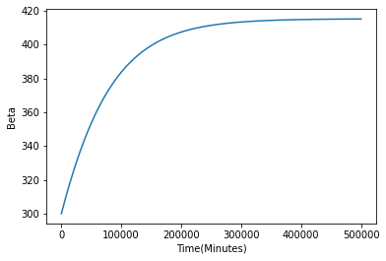
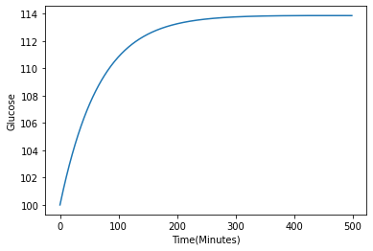
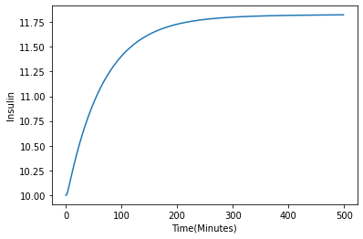
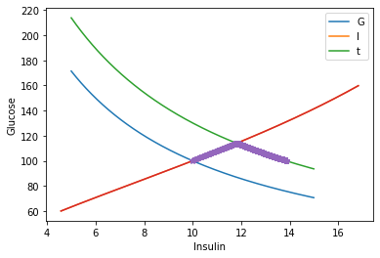
Slow Dynamics - Subclinical Diabetes - Insulin resistance Models
dβ/dt = (- d₀+ r₁*G - r₂*G²) β

Slide 10
Subclinical diabetes (not prediabetes) Insulin resistance due to obesity
Observation of a 43% higher b-cell mass in normoglycemic subjects with insulin resistance due to obesity (Kloppel et al., 1985).

Slide 11
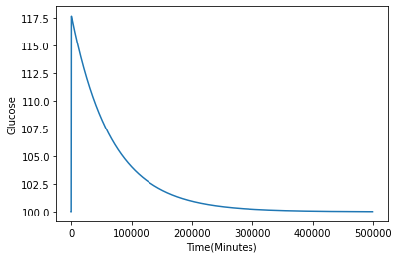
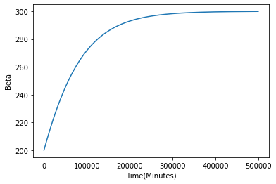
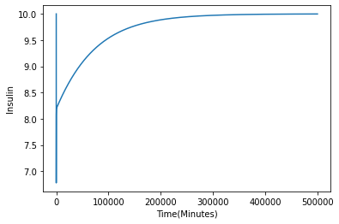
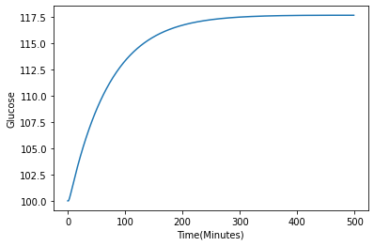
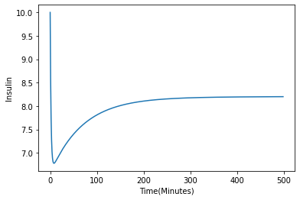
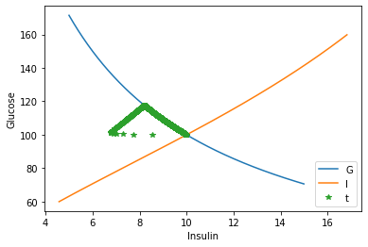
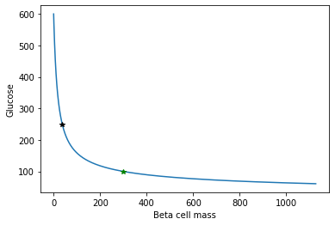
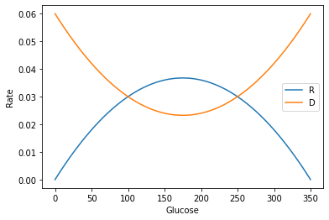
Slow Dynamics – Reduction of beta Mass - Recovery Example(300 to 200)

Slide 12
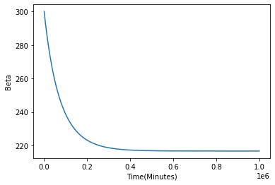
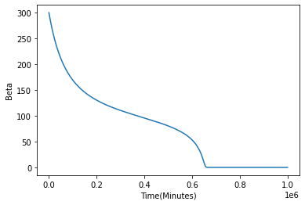
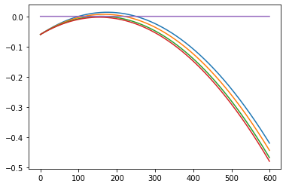
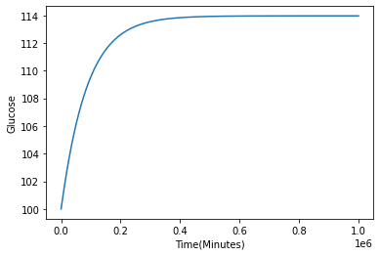
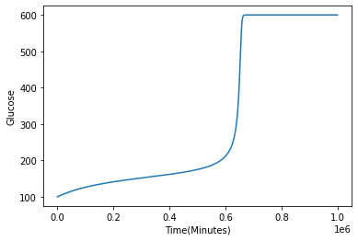
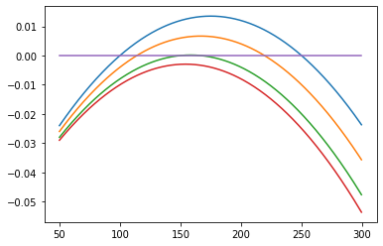
Rate of Death > Rate of Replication (Persistent)

Slide 13
History
Homeostasis model assessment: insulin resistance and b-cell function from fasting plasma glucose and insulin concentrations in man. Diabetologia 28, 412-419. (1985).
MATTHEWS, D. R., HOSKER, J. P., RUDENSKI, A. S.,NAYLOR, B. A., TREACHER, D. T.& TURNER, R. C.
A Model of b-Cell Mass, Insulin, and Glucose Kinetics: Pathways to Diabetes. 2000
BRIAN TOPP*, KEITH PROMISLOW-, GERDA DEVRIES?, ROBERT M. MIURAA AND DIANE T. FINEGOOD*E
A Mathematical Model of the Pathogenesis, Prevention, and Reversal of Type 2 Diabetes - 2015
Joon Ha, Leslie S. Satin, and Arthur S. Sherman

